Slide 1

Download & Installation instructions Xilinx Vivado
Version 2019.2.1

Slide 2
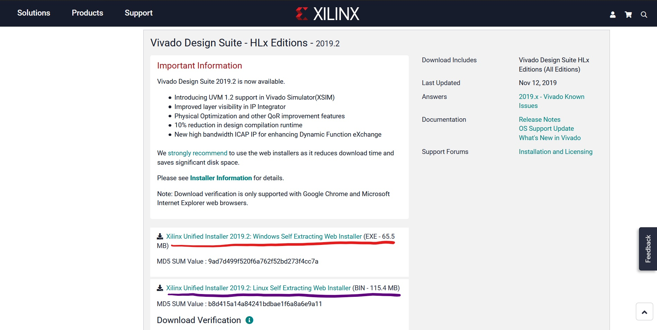
Go to download website https://www.xilinx.com/support/download/index.html/content/xilinx/en/downloadNav/vivado-design-tools/2019-2.html
Select this for windows machine

Slide 3
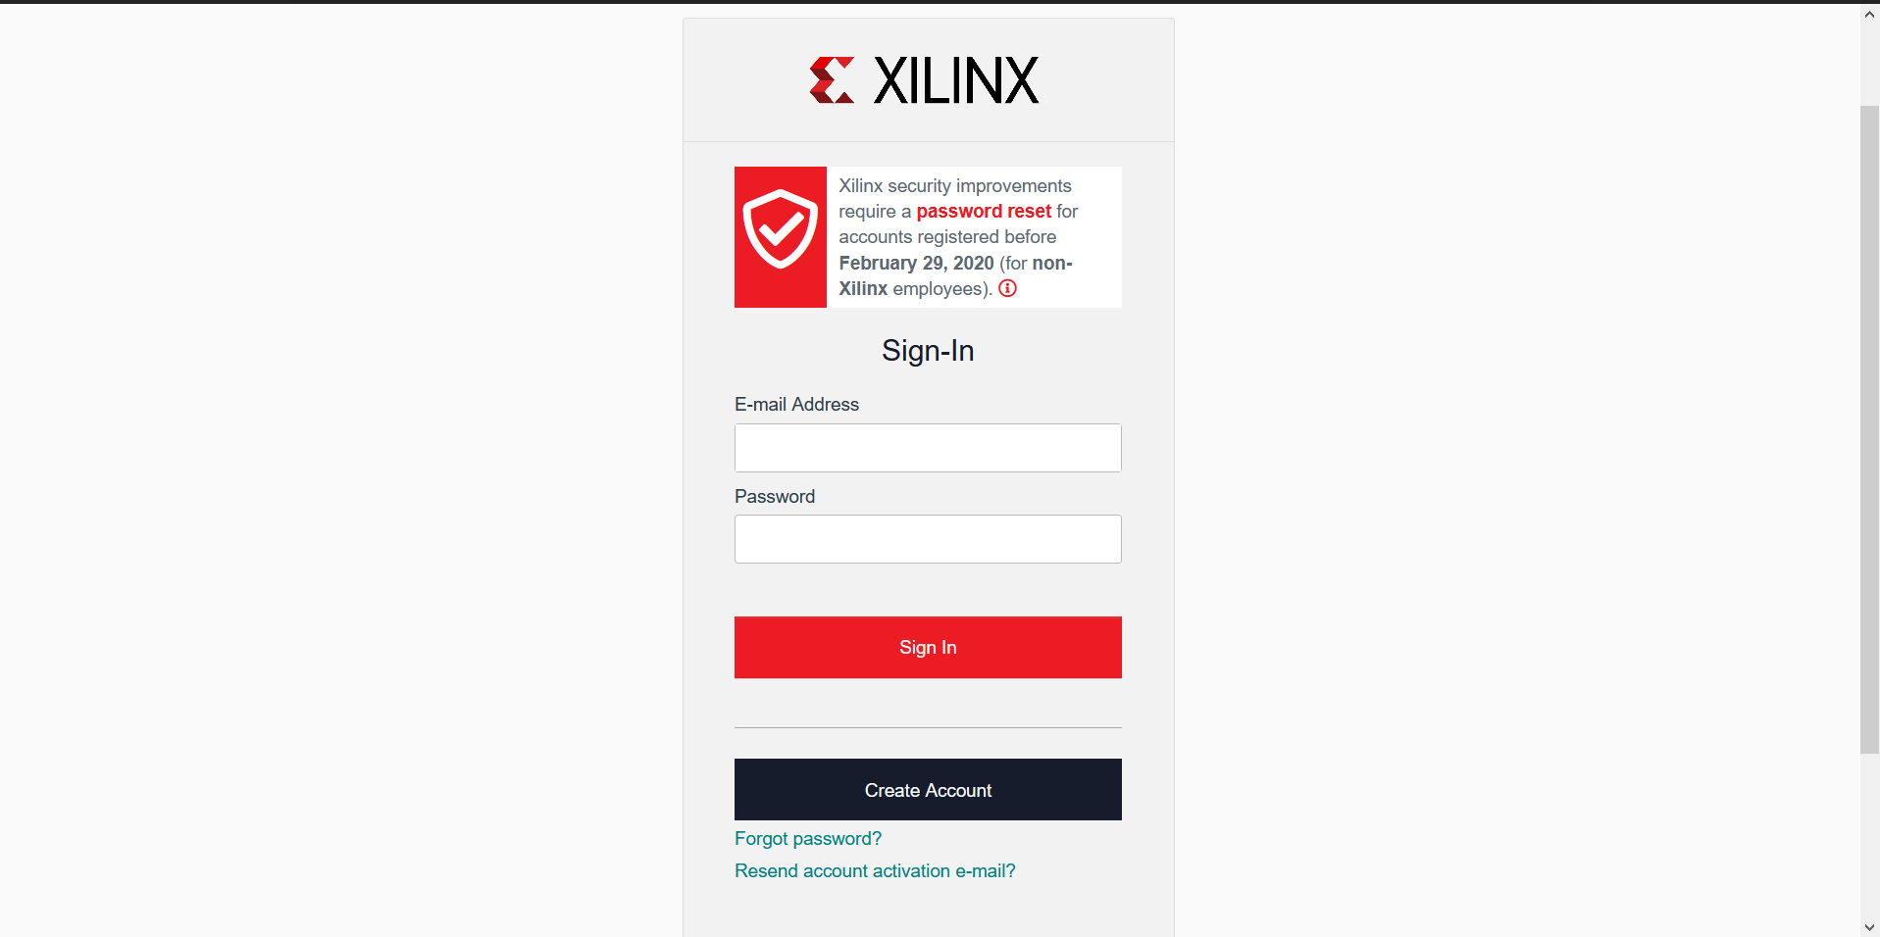
Sign into Xilinx account (Create one with preferably UofA email ID if new user, then sign in)

Slide 4
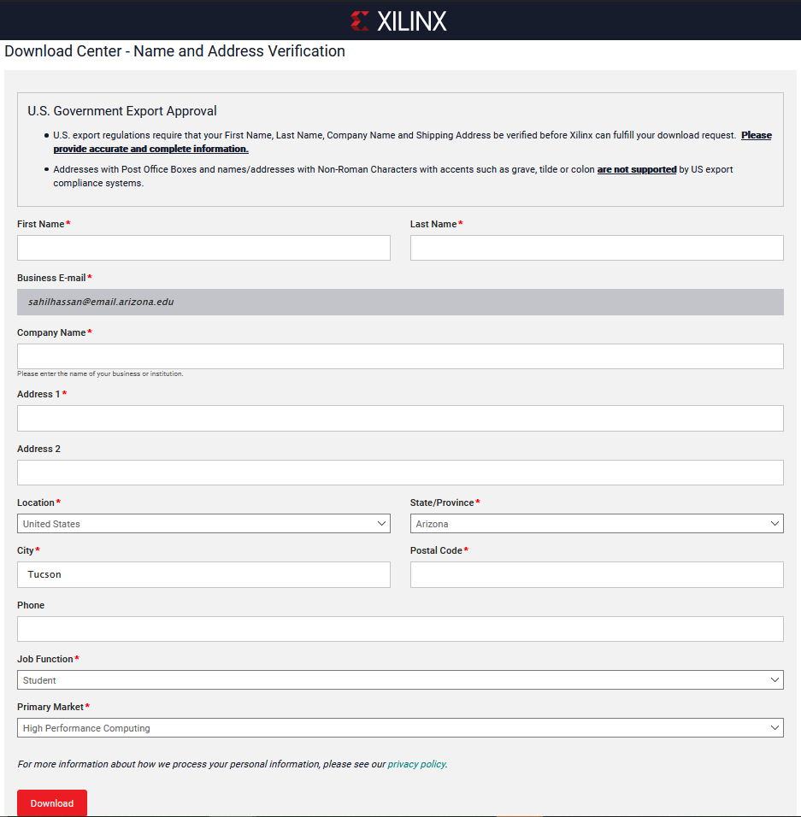
Fill out verification form and hit Download

Slide 5
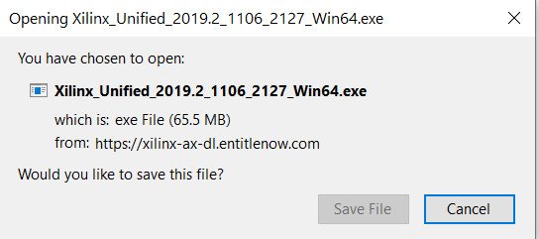
The following file should be downloaded

Slide 6
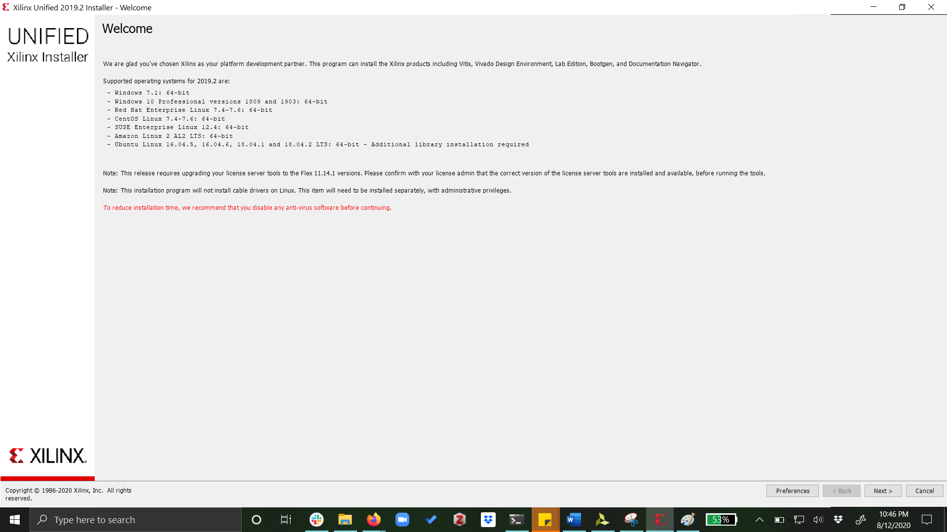
Run the installer to get the following interface

Slide 7
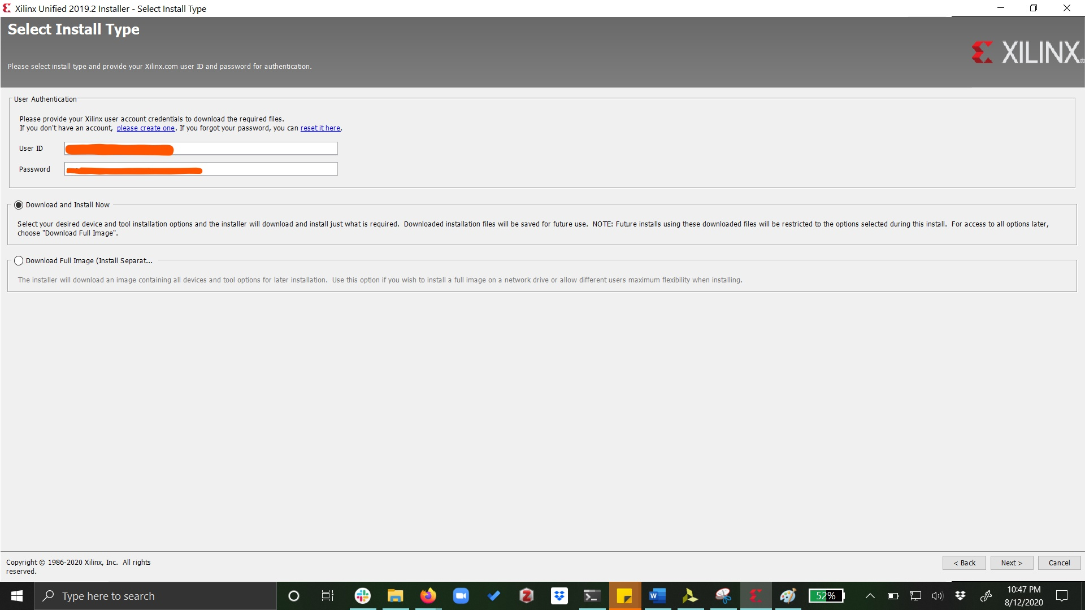
Continue by signing in
Sign in with your Xilinx account credentials

Slide 8
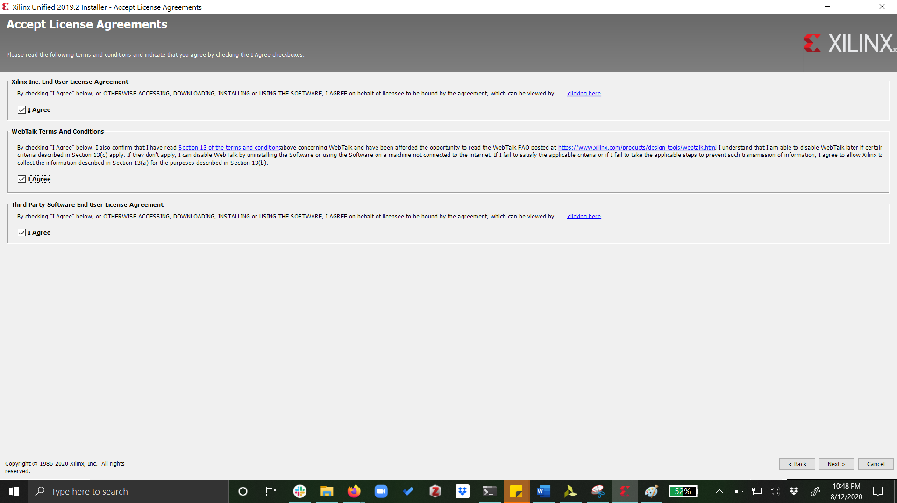
Agree to the terms and proceed next

Slide 9
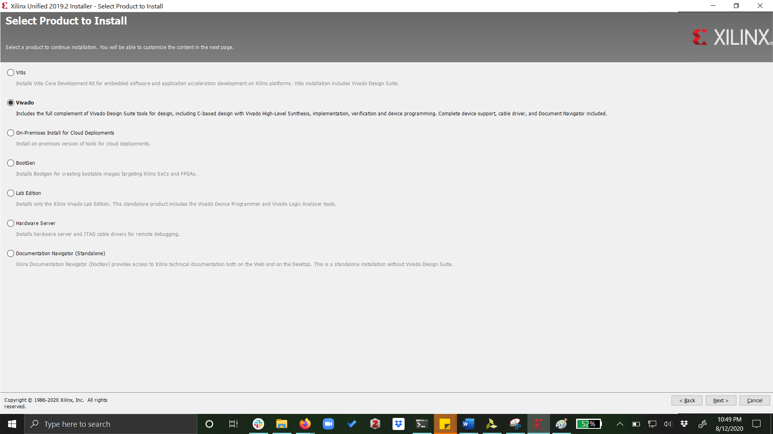
Select Vivado as product and proceed next

Slide 10
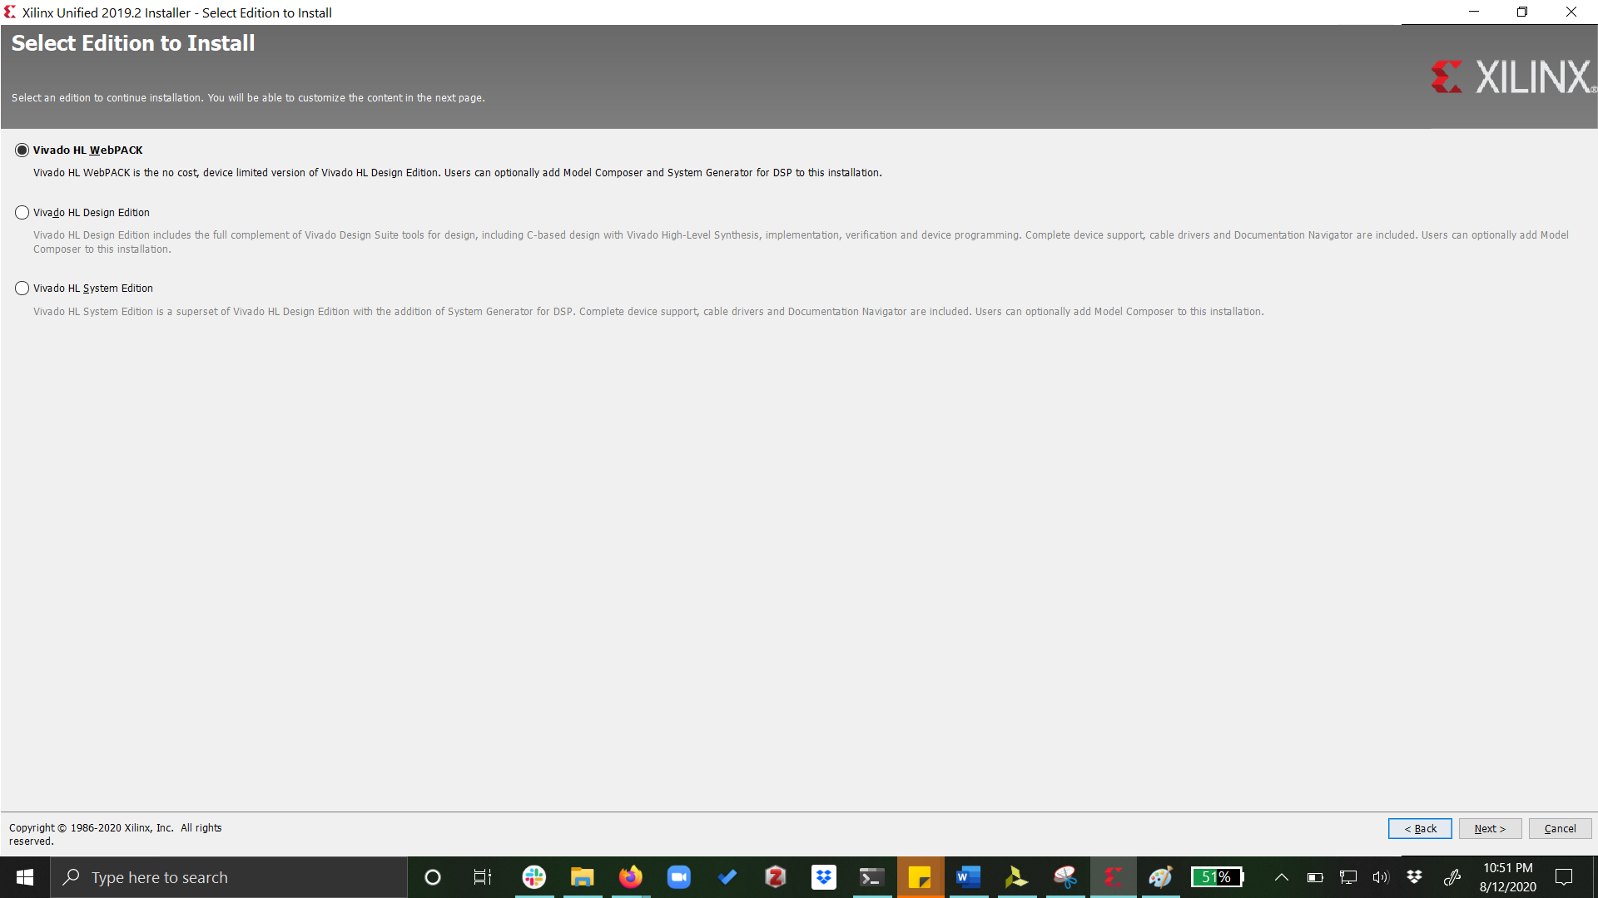
Select Vivado HL Webpack edition and proceed

Slide 11
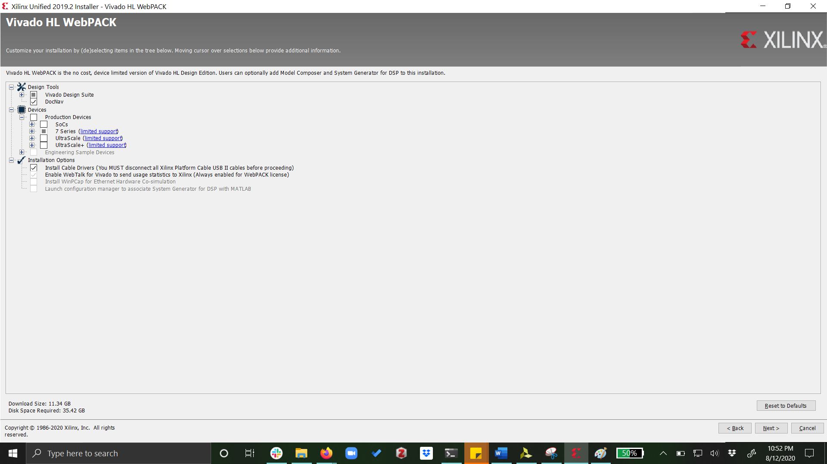
Continue with following components selected
Required diskspace must be available

Slide 12
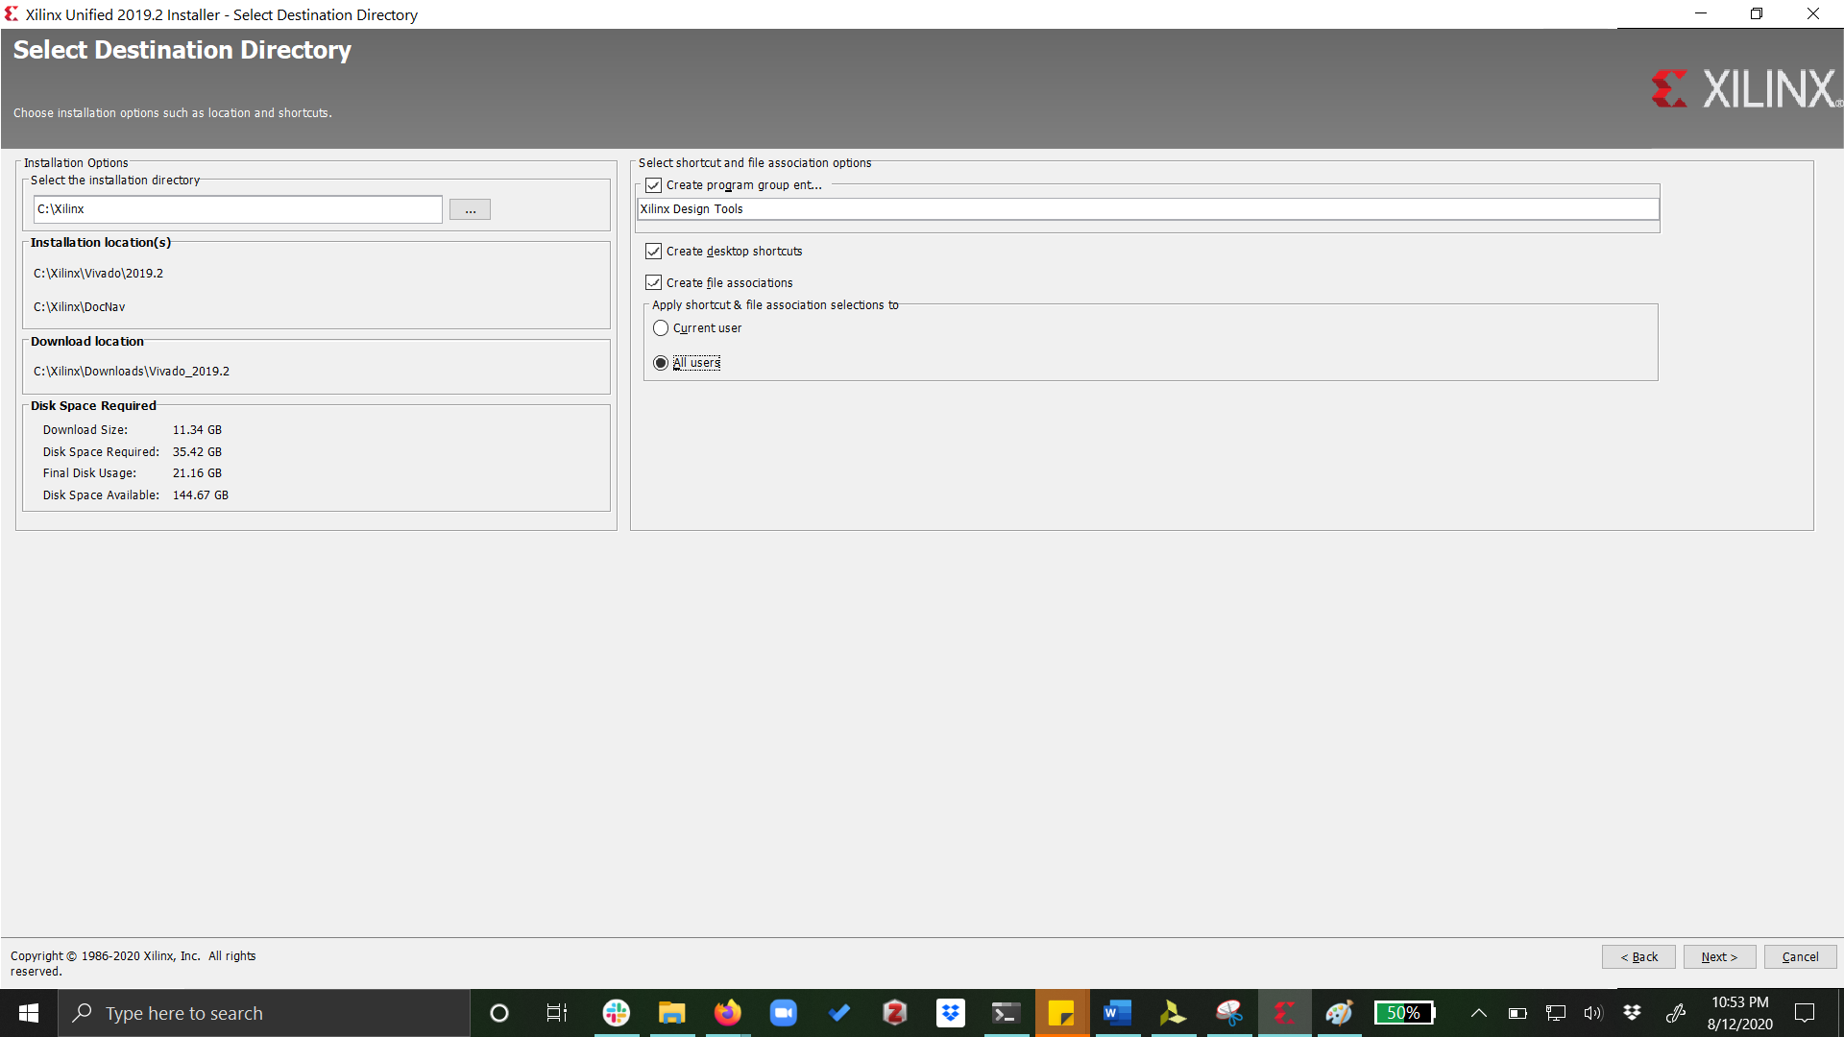
Provide installation path or go with default path
Optionally, install for all users

Slide 13
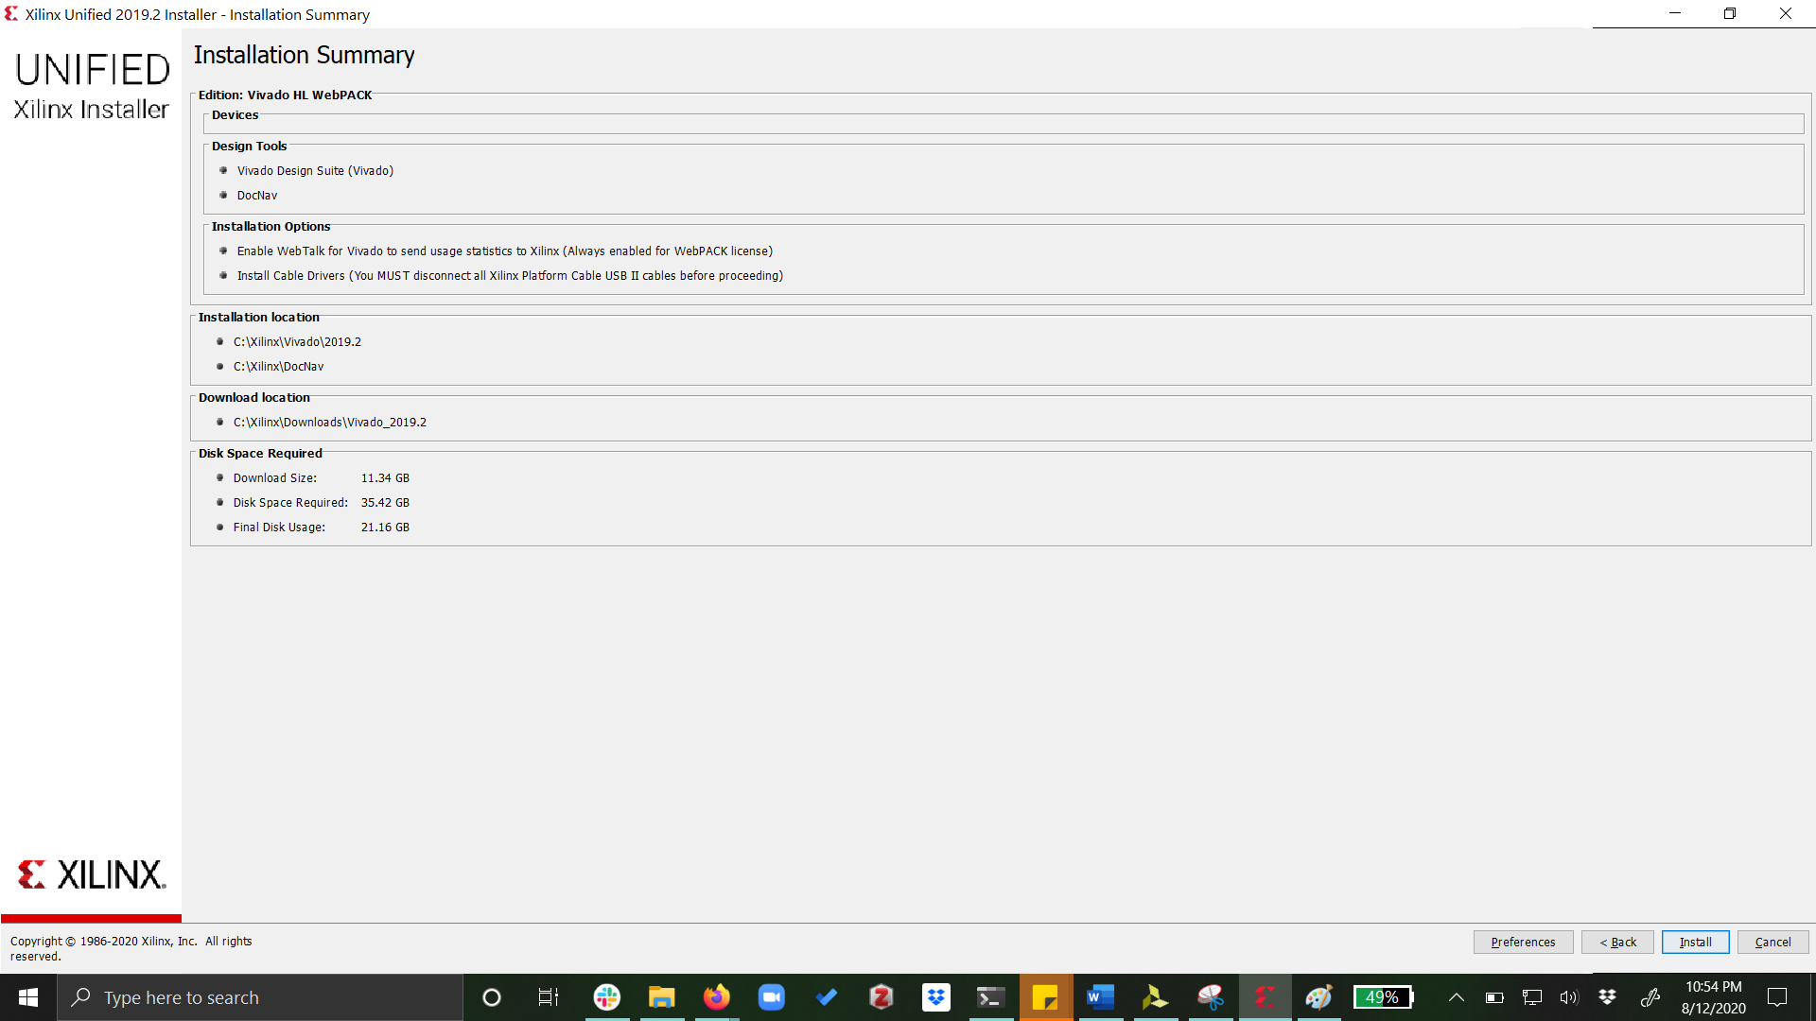
Review all the choices, then hit ‘Install’

Slide 14
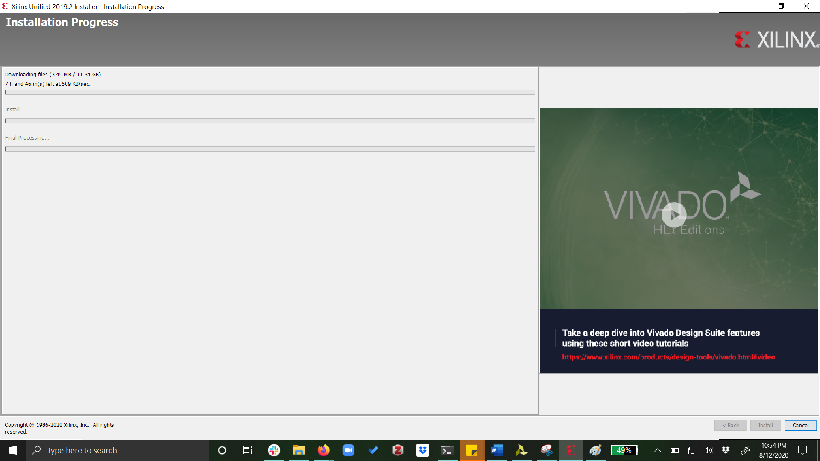
Installation begins, this will take a while

Slide 15
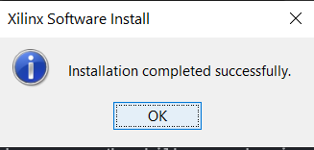
Wait until receiving Installation complete notification

Slide 16
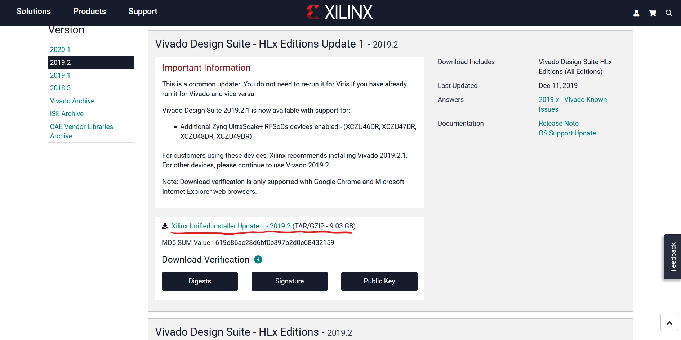
Continued: Installing Update 1 on Vivado 2019.2.0 Go to https://www.xilinx.com/support/download/index.html/content/xilinx/en/downloadNav/vivado-design-tools/2019-2.html, and install the Update 1.

Slide 17
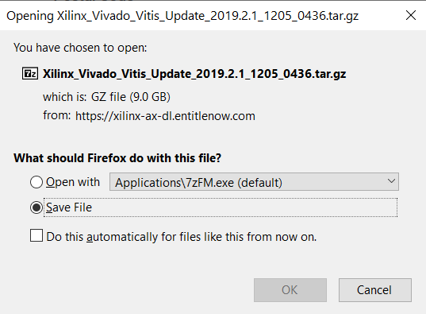
Upon signing in and filling out verification form, following file should be downloaded

Slide 18
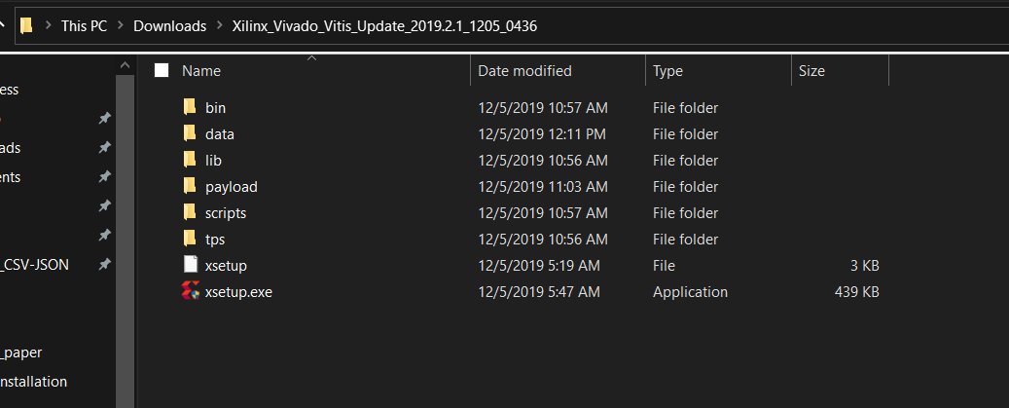
Unzip the .tar.gz file twice (with 7 zip) to find the following files. Run ‘xsetup.exe’

Slide 19
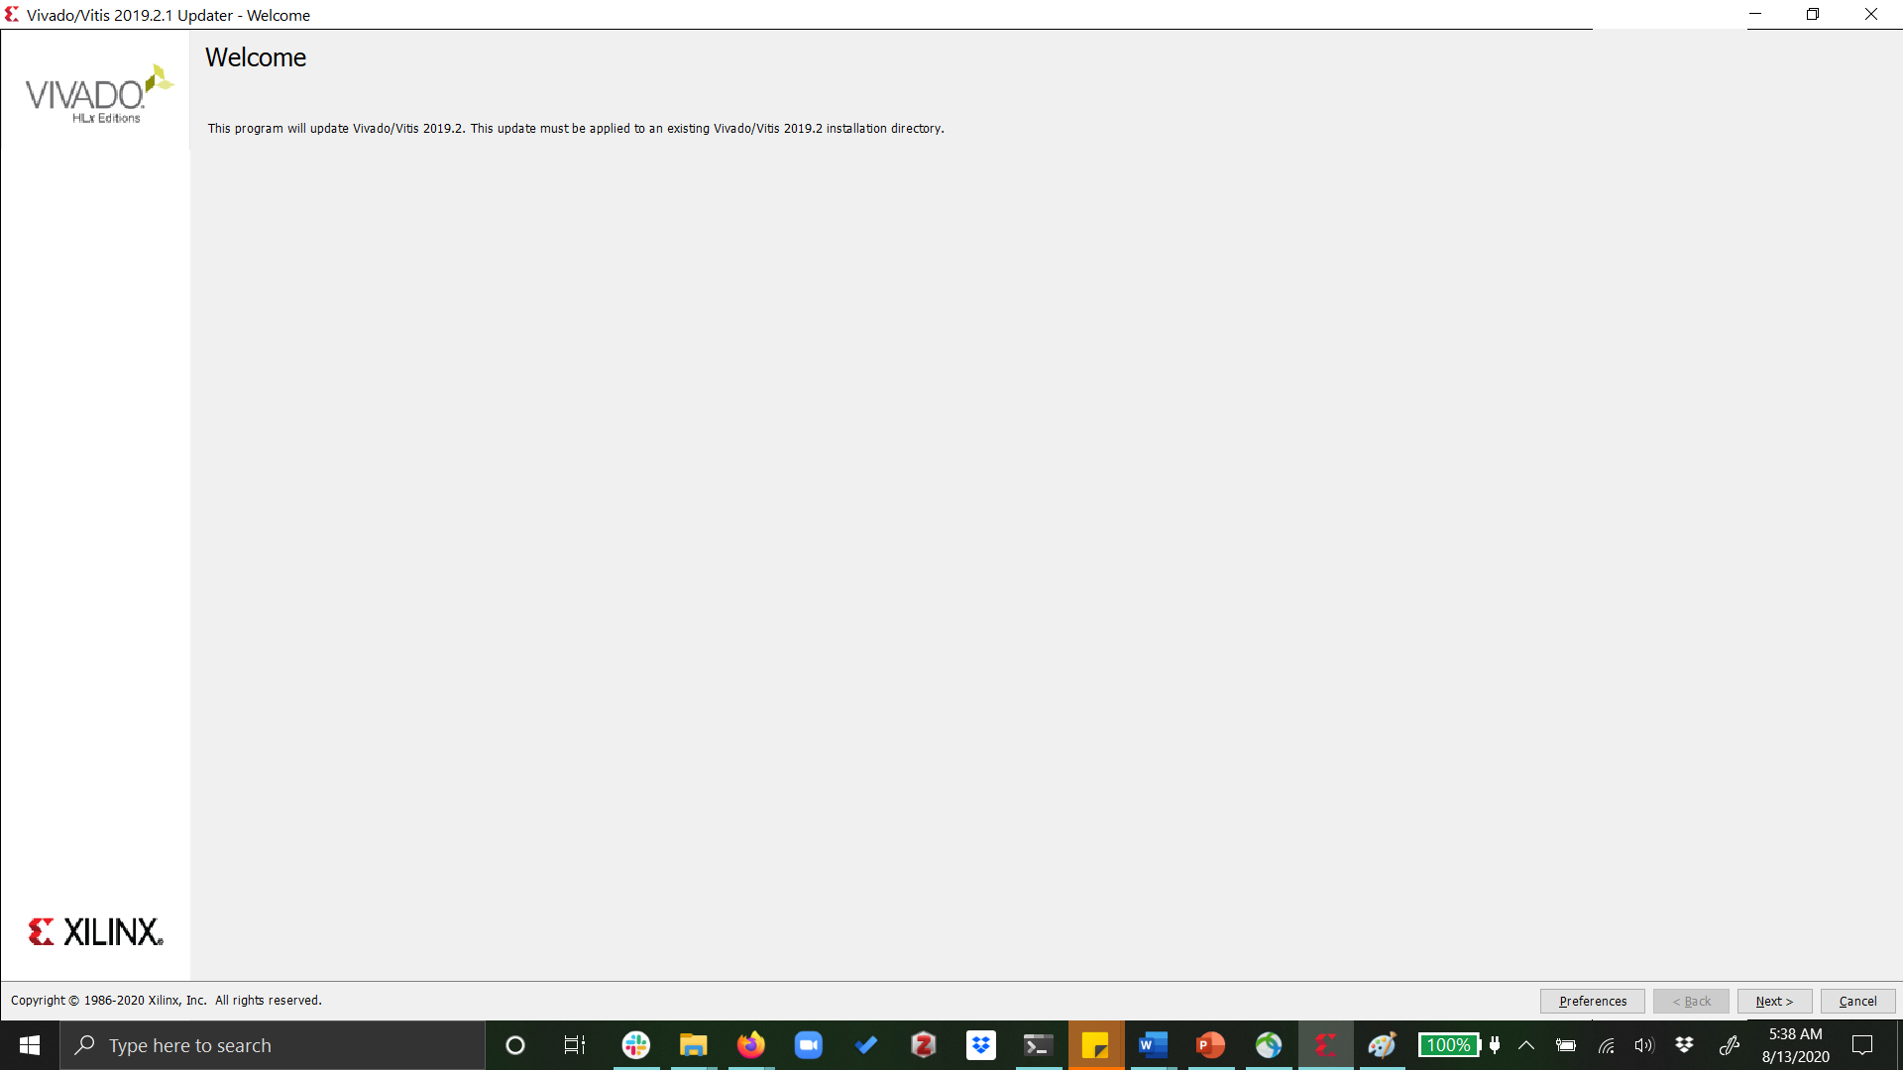
Following installation interface should open

Slide 20
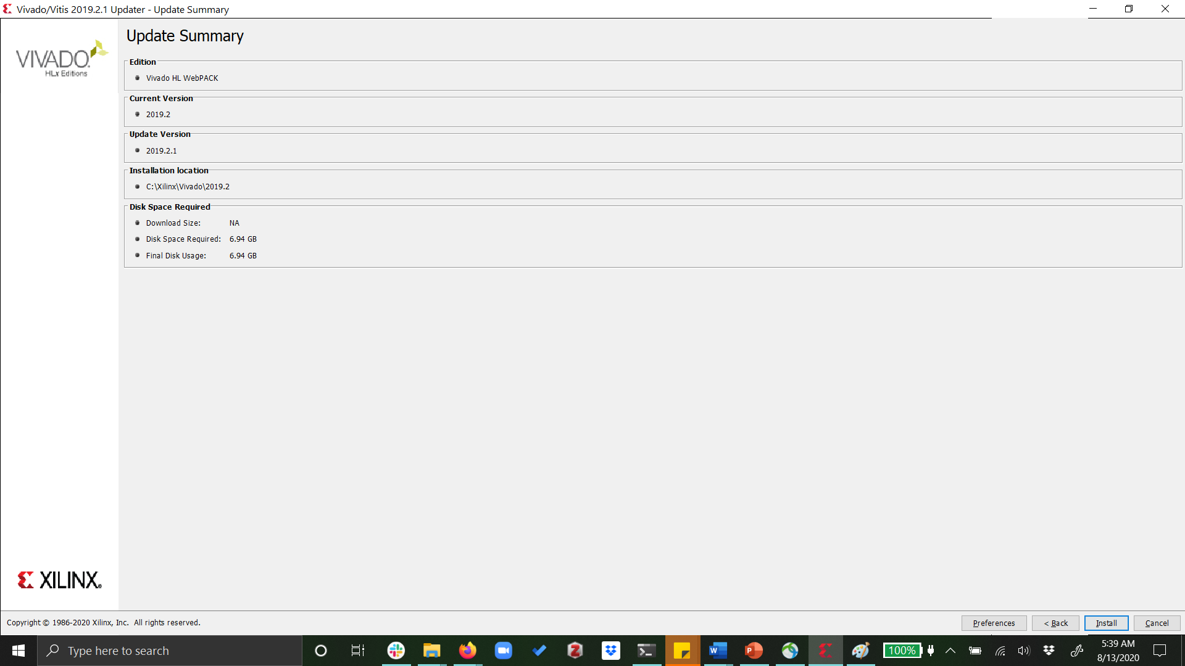
Check information and hit ‘Install’
Make sure required space is available

Slide 21
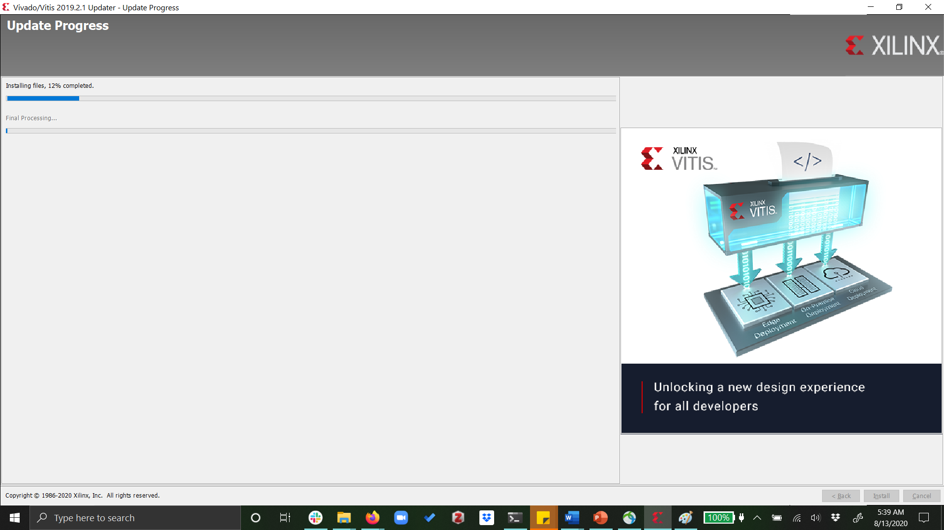
Wait for Installation to complete

Slide 22
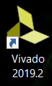
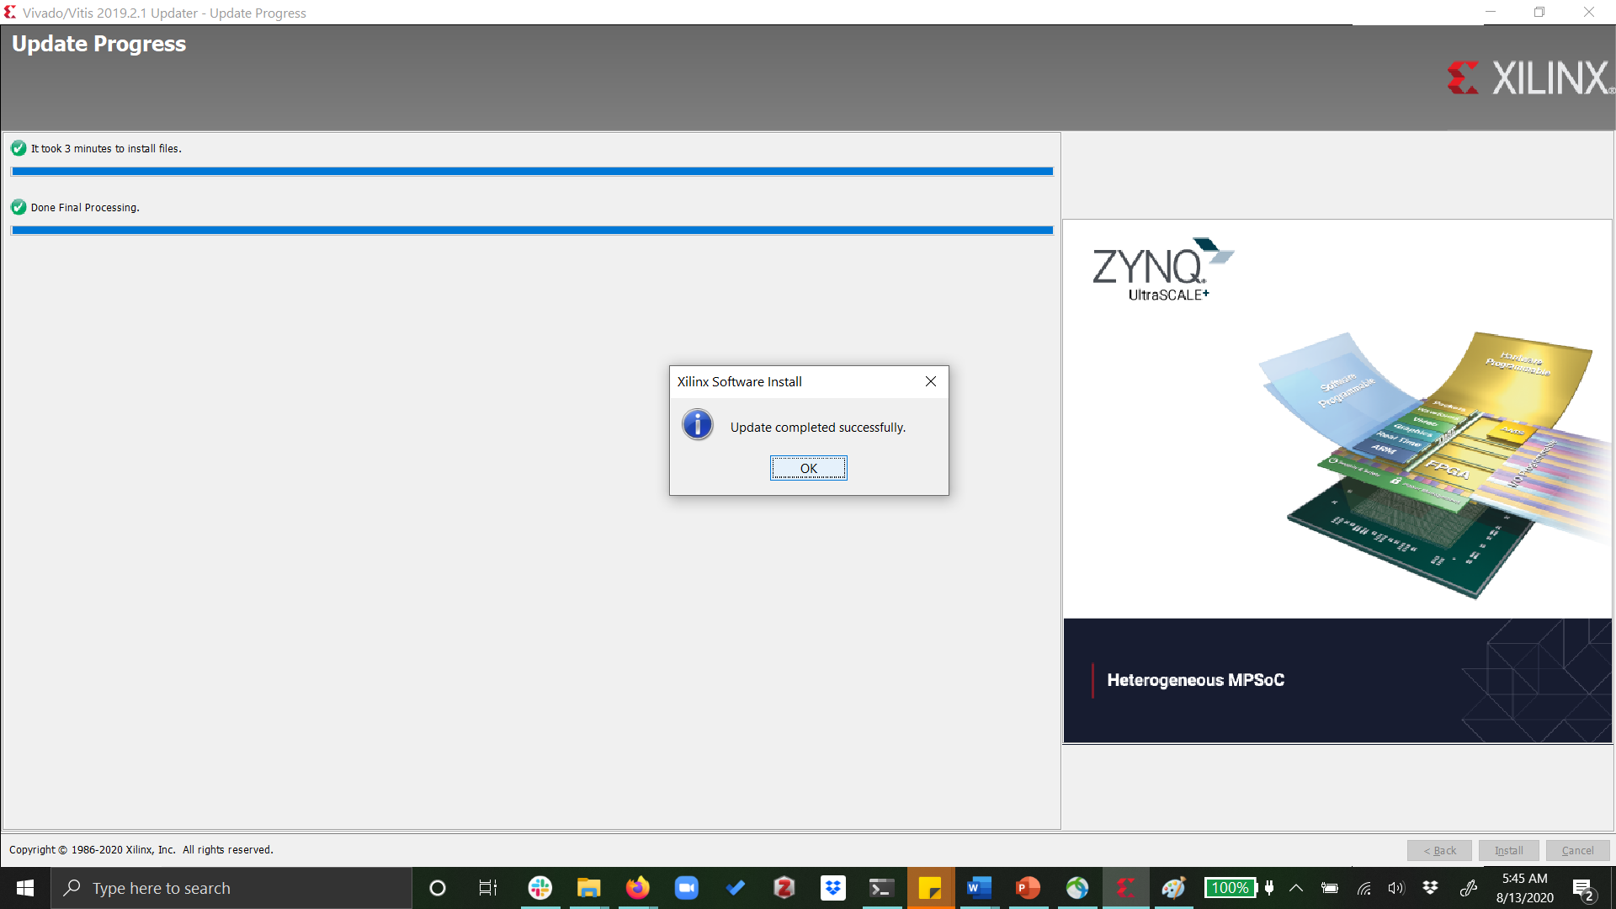
Installation Complete!!! Run from Desktop!

